Slide 1
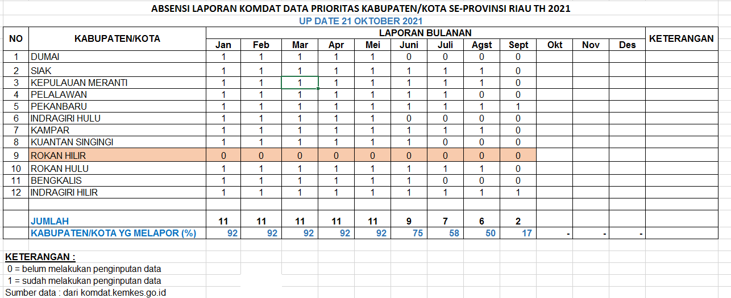

Slide 2
2. DATA DASAR TH 2020
KODE | KAB/KOTA | PUSKESMAS | SUDAH DIINPUT | BELUM DIINPUT/ SELISIH
1401 | KUANSING | 23 | 23 | 0
1402 | INHU | 18 | 20 | -2
1403 | INHIL | 26 | 26 | 0
1404 | PELALAWAN | 14 | 14 | 0
1405 | SIAK | 15 | 15 | 0
1406 | KAMPAR | 31 | 31 | 0
1407 | ROHUL | 21 | 21 | 0
1408 | BENGKALIS | 18 | 18 | 0
1409 | ROHIL | 19 | 19 | 0
1410 | KEP.MRANRI | 10 | 10 | 0
1471 | PEKANBARU | 21 | 2 | 19
1473 | KOTA DUMAI | 10 | 10 | 0

Slide 3
REKAP ABSENSI PROFIL KABUPATEN/KOTA TH.2020 ok
NO. | KABUPATEN/KOTA |  | ABSENSI |  | KETERANGAN
 |  |  | SOFTCOPY | HARDCOPY
1. | Kuansing |  | 0 | 0 | Draf / Belum selesai
2. | Indragiri Hulu |  | 1 | 0 | hardcopy belum diterima
3. | Indragiri Hilir |  | 0 | 0 | Draf / Belum selesai
4. | Pelalawan |  | 1 | 1 | Lengkap
5 | Siak |  | 0 | 0 | Belum selesai/draf
6 | Kampar |  | 1 | 1 | lengkap
7 | Rokan Hulu |  | 1 | 0 | hardcopy belum diterima
8 | Bengkalis |  | 1 | 0 | hardcopy belum diterima
9 | Rokan Hilir |  | 1 | 0 | hardcopy belum diterima
10 | Pekanbaru |  | 1 | 0 | hardcopy belum diterima
11 | Dumai |  | 1 | 1 | lengkap
12 | Kep.Meranti |  | 1 | 0 | hardcopy belum diterima
jumlah |  |  | 9 | 3
Keterangan :
0 = Belum diterima
1 = Sudah diterima

Slide 4
ABSENSI LAPORAN SPM KABUPATEN/KOTA TW 1-3 TH 2021
UP DATE 14 OKTOBER 2021
NO | KABUPATEN/KOTA | SASARAN | TW 1 |  | TW 2 |  | TW 3 |  | TW 4 |  | KETERANGAN
 |  |  | Realisasi kegiatan | Realisasi Anggaran | Realisasi kegiatan | Realisasi Anggaran | Realisasi kegiatan | Realisasi Anggaran | Realisasi kegiatan | Realisasi Anggaran
1 | DUMAI | 19-Mar | 19-Mar | 1 | 0 | 1 | 0 | 0
2 | SIAK | 08-Feb | 20-Sep | 20-Sep | 20-Sep | 20-Sep | 0 | 0
3 | KEPULAUAN MERANTI | 24 Agst | 25 Agst | 0 | 25 Agst | 0 | 0 | 0
4 | PELALAWAN | 02-Jun | 10-Jun | 10-Jun | 23 Agst | 23 Agst | 0 | 1 |  |  | belum lengkap
5 | PEKANBARU | 03-Mei | 1 | 0 | 02-Sep | 0 | 0 | 0
6 | INDRAGIRI HULU | 29-Apr | 05-Mei | 05-Mei | 15-Sep | 15-Sep | 0 | 0
7 | KAMPAR | 30-Jul | 10 Agst | 10 Agst | 10 Agst | 10 Agst | 0 | 0
8 | KUANTAN SINGINGI | 0 | 0 | 0 | 0 | 0 | 0 | 0 |  |  | belum melakukan penginputan
9 | ROKAN HILIR | 20-Jun | 1 | 0 | 0 | 0 | 0 | 0
10 | ROKAN HULU | 22-Apr | 23-Apr | 1 | 06-Okt | 1 | 0 | 1
11 | BENGKALIS | 28-Mei | 12-Jul | 12-Jul | 1 | 1 | 0 | 0
12 | INDRAGIRI HILIR | 1 | 0 | 0 | 0 | 0 | 0 | 0 |  |  | belum melakukan penginputan
 | JUMLAH | 11 | 10 | 7 | 8 | 7 | 0 | 2
 | KABUPATEN/KOTA YG MELAPOR (%) | 92 | 83 | 58 | 67 | 58 | - | 17 | - | -
Sumber : Aplikasi Komdat.kemkes.go.id:8080

Slide 5
